Slide 1
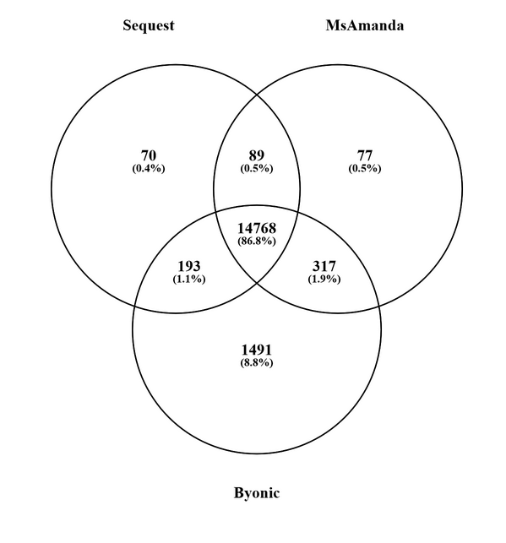
Peptide IDs in Byonic versus others in PD2.2
PD2.2 | human+Ecoli fr7,8,9 TMT10plex
Unique peptide sequences (M ox modification not counted as extra peps)
Byonic | 16769
Sequest-Percolator | 15251
MSAmanda-Percolator | 15120

Slide 2
TMT acc. in Byonic versus others in PD2.2 3-4-3 TMT loading scheme with 1:2:6 pipetted ratios of E.coli peptides into human background

